Slide 1
JAVA
UNIT 6

Slide 2
Exception handling
The Exception Handling in Java is one of the powerful mechanism to handle the runtime errors so that normal flow of the application can be maintained.
What is exception: An exception is an unwanted or unexpected event, which occurs during the execution of a program i.e. at run time, that disrupts the normal flow of the program’s instructions.

Slide 3
Error vs Exception
Error: An Error indicates serious problem that a reasonable application should not try to catch. It is not recoverable. Exception: Exception indicates conditions that a reasonable application might try to catch. It is recoverable

Slide 4
Types of Java Exceptions
There are mainly two types of exceptions: checked and unchecked. Here, an error is considered as the unchecked exception. According to Oracle, there are three types of exceptions:
Checked Exception
Unchecked Exception
Error

Slide 5
Types of Java Exceptions
Checked Exception: Checked exceptions are checked at compile-time. e.g. IOException, SQLException etc.
2) Unchecked Exception: Unchecked exceptions are not checked at compile-time, but they are checked at runtime. e.g. ArithmeticException, NullPointerException, ArrayIndexOutOfBoundsException etc.
3) Error: Error is irrecoverable e.g. OutOfMemoryError, VirtualMachineError, AssertionError etc.

Slide 6
Java Exception Keywords
try | The "try" keyword is used to specify a block where we should place exception code. The try block must be followed by either catch or finally. It means, we can't use try block alone.
catch | The "catch" block is used to handle the exception. It must be preceded by try block which means we can't use catch block alone. It can be followed by finally block later.
finally | The "finally" block is used to execute the important code of the program. It is executed whether an exception is handled or not.
throw | The "throw" keyword is used to throw an exception.
throws | The "throws" keyword is used to declare exceptions. It doesn't throw an exception. It specifies that there may occur an exception in the method. It is always used with method signature.

Slide 7
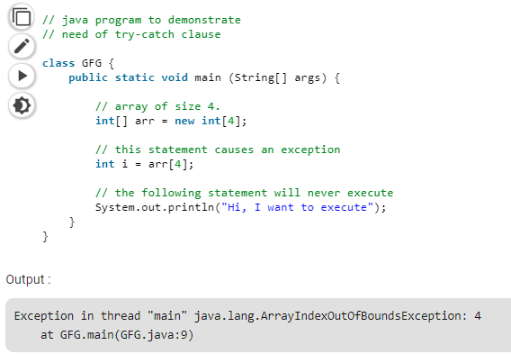
Exception Example

Slide 8
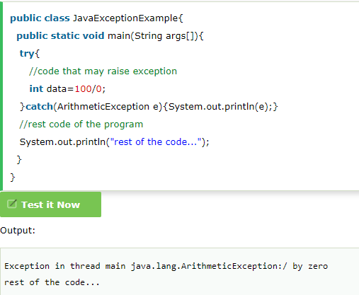
Java Exception Handling Example

Slide 9
Java Multi-catch block
A try block can be followed by one or more catch blocks. Each catch block must contain a different exception handler. So, if you have to perform different tasks at the occurrence of different exceptions, use java multi-catch block.
At a time only one exception occurs and at a time only one catch block is executed.
All catch blocks must be ordered from most specific to most general, i.e. catch for ArithmeticException must come before catch for Exception.

Slide 10
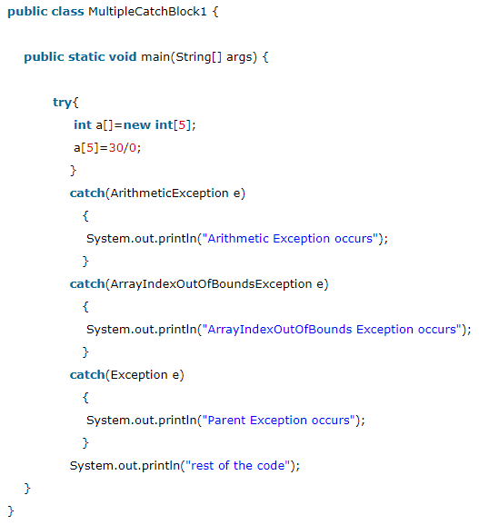
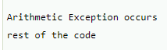
Example
Output

